Slide 1
PYTHON WHILE LOOPS

Slide 2
Profit Loops
Python has two primitive loop commands: while loops
for loops
The while Loop
With the while loop we can execute a set of statements as long as a condition is true.
The while loop requires relevant variables to be ready, in this example we need to define an indexing variable, i, which we set to 1.

Slide 3
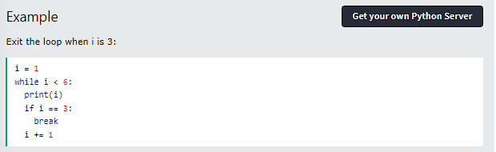
The break Statement
With the while loop we can execute a set of statements as long as a condition is true.

Slide 4
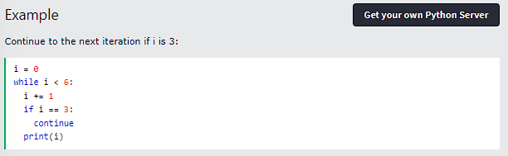
The continue Statement
With the continue statement we can stop the current iteration, and continue with the next:

Slide 5
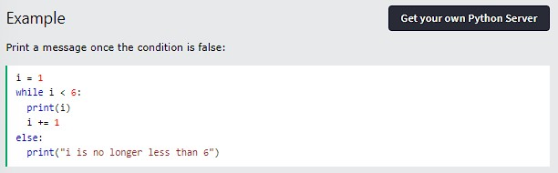
The else Statement
With the else statement we can run a block of code once when the condition no longer is true:

Slide 6
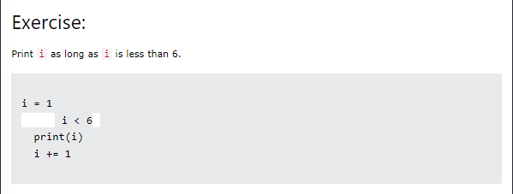
Test Yourself With Exercises

